Slide 1

Code Capture
Turn code on your screen into clean, verified, documented code.
A team of AI agents · reads · checks · diagrams
Ledelsea · Team Demo

Slide 2
The problem
Code you want is often trapped where you can't copy it — and retyping introduces bugs.
1
Trapped in images
Screenshots, slides, videos, PDFs, and shared screens — no copy button.
2
Retyping is error-prone
Manually re-entering code is slow and quietly introduces typos and bugs.
3
Plain OCR isn't enough
You get messy text back — not clean, verified, runnable code.

Slide 3
What it does
1
2
3
4
Capture
Read faithfully
Compiler-verify
Report
Screenshot the screen — even while scrolling.
Transcribe the code exactly, as-is.
Check it with the real compiler.
Overview, tech review, and diagrams.
Everything runs from a double-click Mac app, built on the Anthropic API.

Slide 4
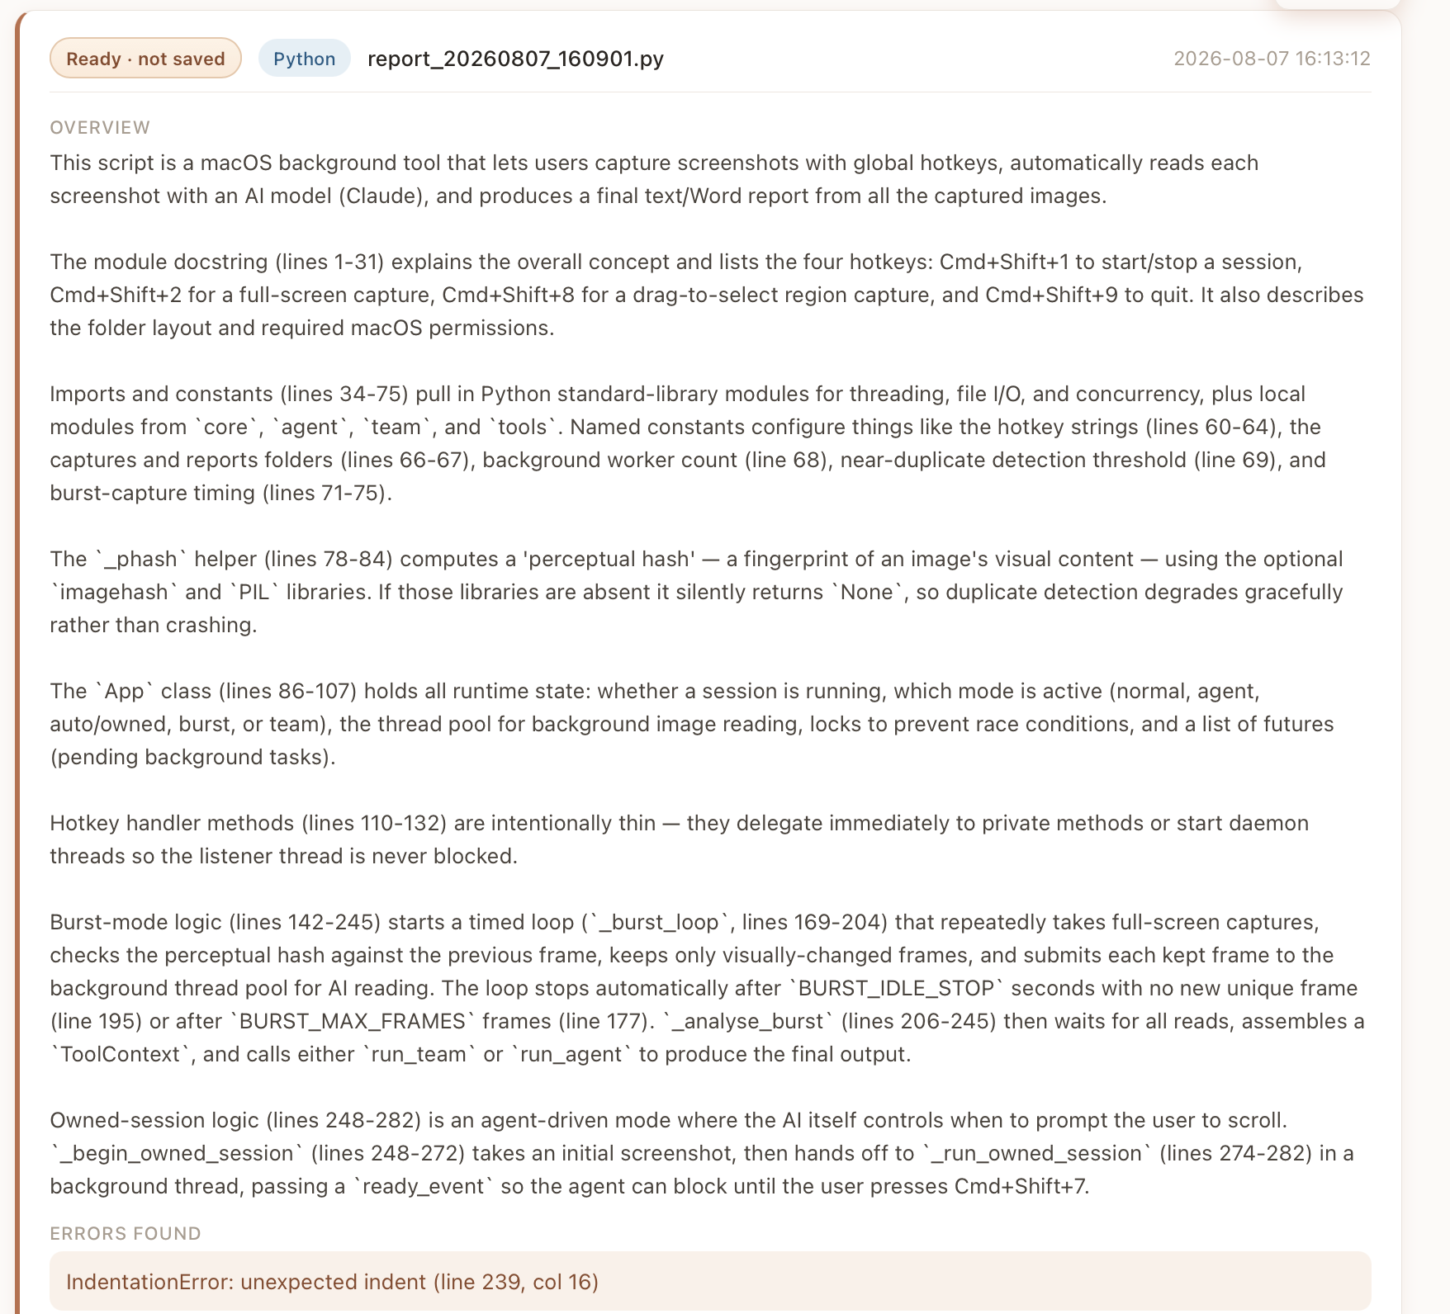
▶
Live Demo
Start capture
Switch to the editor → press Cmd+Shift+1
Scroll slowly (or not at all for a one-screen file)
Walk the report: overview · errors · code · tech review · diagrams
Backup slot
(paste a rehearsal report screenshot here)
Line numbers OFF · file fits the screen · keep this backup ready

Slide 5
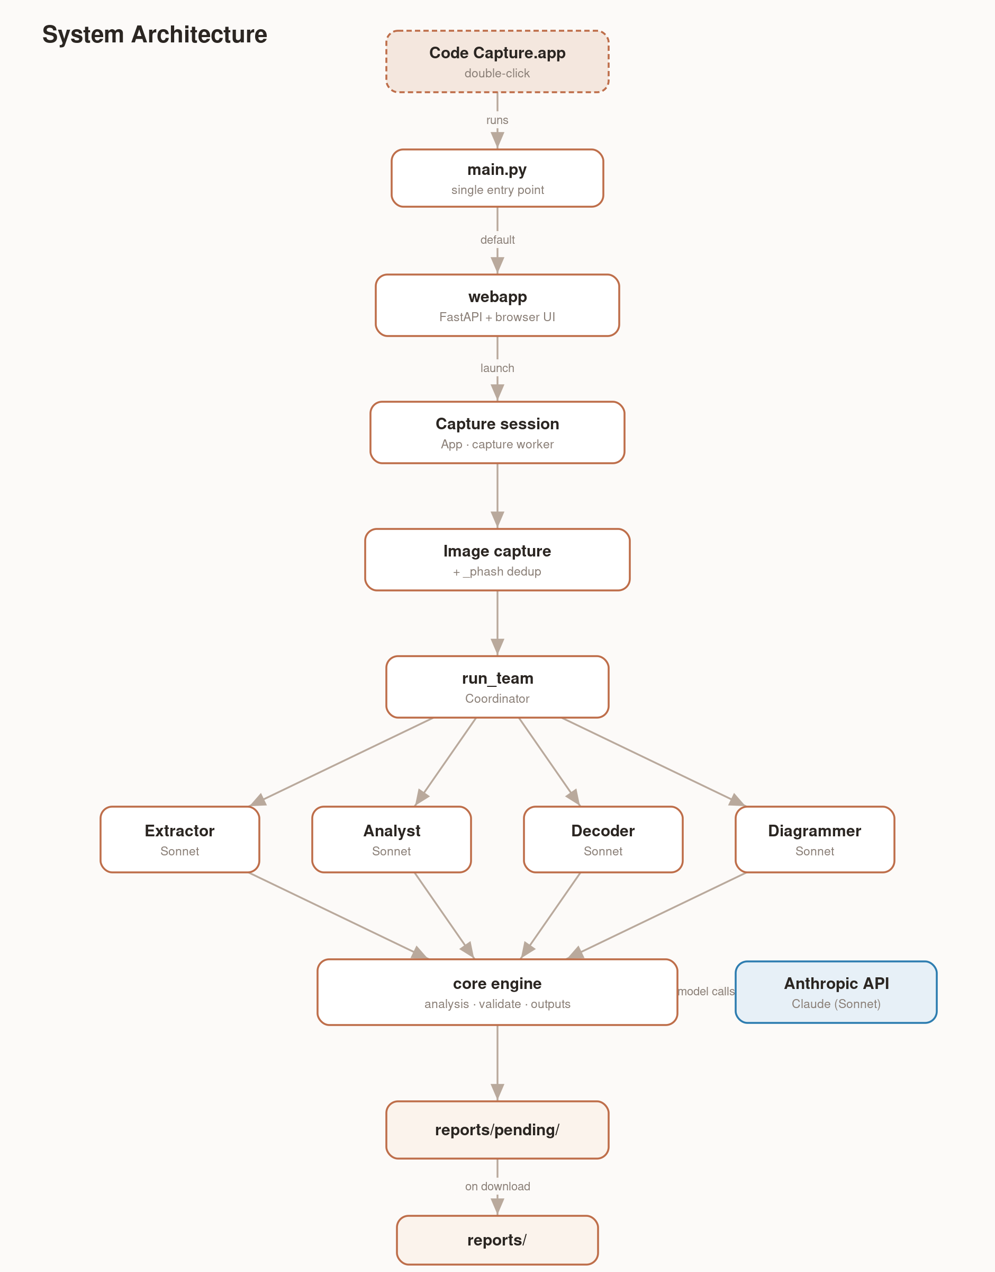
How it works — a team of agents
Coordinator runs the team
Extractor transcribes exactly — can't rewrite logic
Analyst overview + tech-stack review
Decoder runs the compiler, fixes only real errors
Diagrammer draws the diagrams

Slide 6
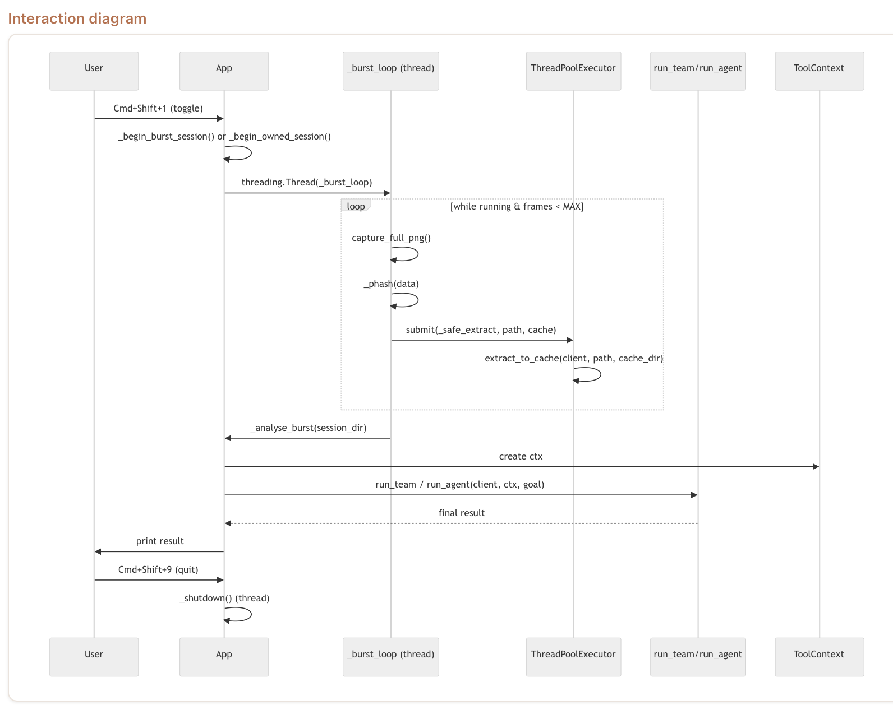
Verified & documented
Compiler-verified output
“Errors: None” means we ran it through the real compiler.
Catches real errors
Genuine bugs are surfaced by the compiler, not guessed.
Auto-generated diagrams
Class, interaction, and component diagrams — drawn from the code.
Example: a real report from a rehearsal run
Paste a report / diagram screenshot here

Slide 7
What's next
Documents soon
Data extract soon
summarize articles, notes, PDFs
pull tables & structured data
Point Code Capture at code anywhere — get back verified, documented, diagrammed results.
Ledelsea

